Slide 1
Database Management System
Relational Algebra
Antu Chowdhury
Lecturer
Dept of CSE, EWU

Slide 2
Relational Query Language
4
Language in which user requests information from the database.
Categories of languages
  Procedural
  Non-procedural, or declarative SQL
“Pure” languages:
  Relational algebra
Pure languages form underlying basis of query languages that people use.

Slide 3
Relational Algebra
4
Procedural language
Six basic operators
  select: σ
  project: ∏
  union: ∪
  set difference: –
  Cartesian product: x
  rename: ρ
The operators take one or two relations as inputs and produce a new relation as a result.

Slide 4
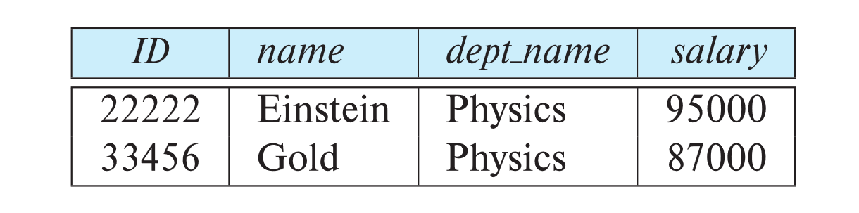
Select Operation
5
The select operation selects tuples that satisfy a given predicate.
Notation: σ _{p} (r)
p is called the selection predicate
Example: select those tuples of the instructor relation where the instructor is in the “Physics” department.
  Query
  σ _{dept_name=“Physics”} (instructor)
  Result

Slide 5
Select Operation
5
We allow comparisons using
=, ≠, >, ≥, <, ≤
in the selection predicate.
We can combine several predicates into a larger predicate by using the connectives:
∧ (and), ∨ (or), ¬ (not)
Example:
1.Find the instructors in Physics with a salary greater $90,000, we write:
σ _{dept_name=“Physics”} ∧ _{salary >} _{90,000} (instructor)

Slide 6
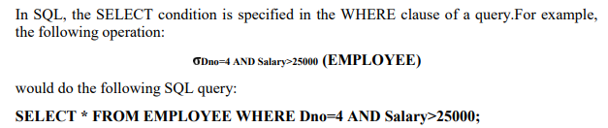
Select Operation
5

Slide 7
Project Operation
5
The PROJECT operation denoted by selects certain columns from the table and discards the other columns
where A₁, A₂ are attribute names and r is a relation name.
The result is defined as the relation of k columns obtained by erasing the columns that are not listed
Duplicate rows removed from result, since relations are sets

Slide 8
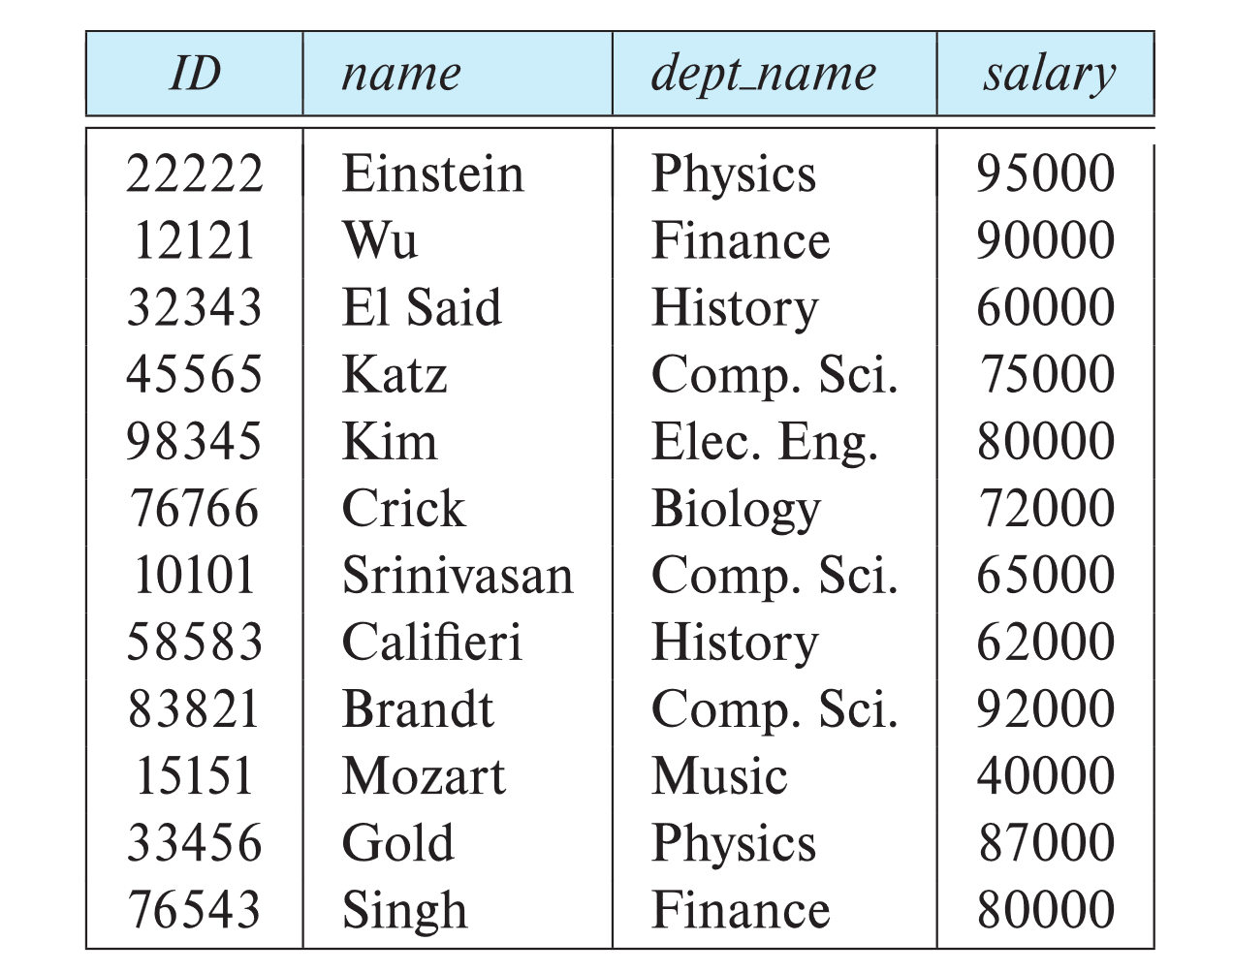
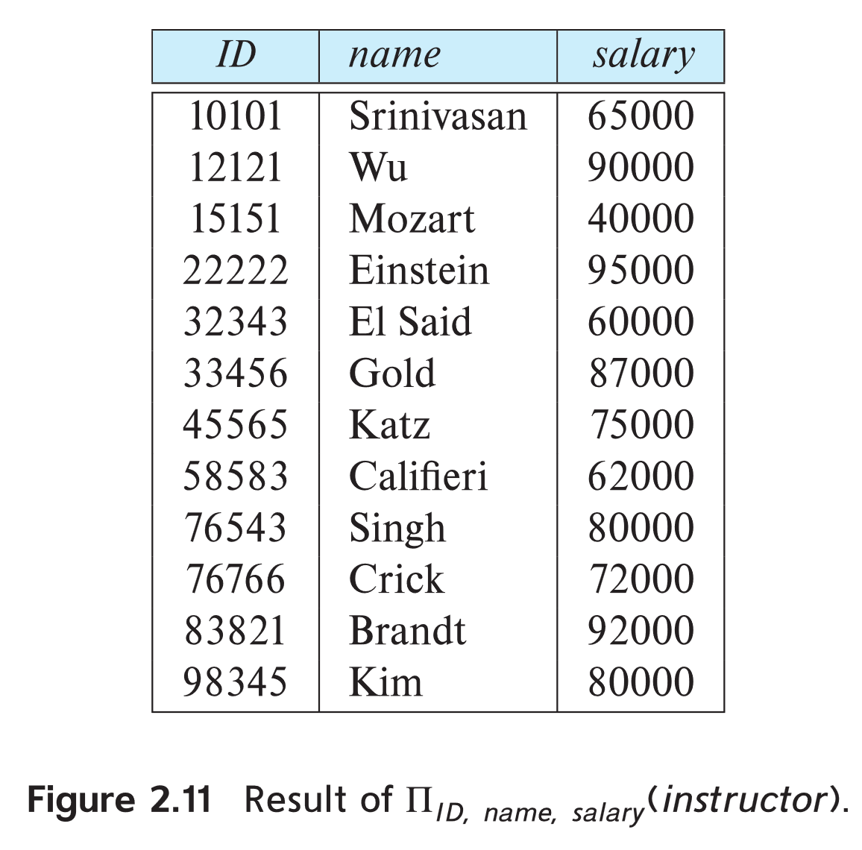
Project Operation
5
Example: eliminate the dept_name attribute of instructor
Query: ∏_{ID, name, salary} (instructor)

Slide 9
Project Operation
5
Example:
Relation r:
A
B
C
A
C
A
C
α
α
β
β
10
20
30
40
1
1
1
2
α
α
β
β
1
1
1
2
∏_{A,C} (r)
α
β
β
1
1
2
=

Slide 10
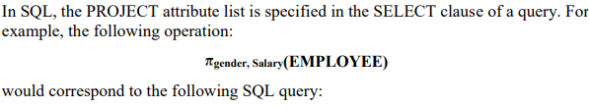
Project Operation
5
SELECT DISTINCT gender, salary FROM EMPLOYEE;

Slide 11
Composition of Relational Operations
5
The result of a relational-algebra operation is relation and therefore of relational-algebra operations can be composed together into a relational-algebra expression.
Consider the query -- Find the names of all instructors in the Physics department.
∏_{name}(σ _{dept_name} _{=“Physics”} (instructor))
IN SQL,
SELECT name
FROM instructor
WHERE dept_name=“Physics”;

Slide 12
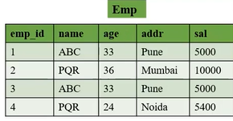
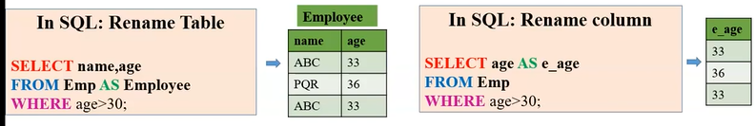
Rename Operation
5
The results of relational-algebra expressions do not have a name that we can use to refer to them. The rename operator, ρ , is provided for that purpose
The expression:
ρ_{x} (E)
Returns the result of expression E under the name x
Another form of the rename operation:
ρ_{x(A1,A2, .. An)} (E)

Slide 13
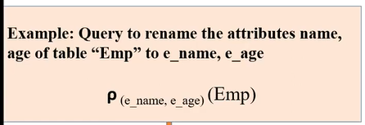
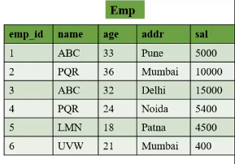
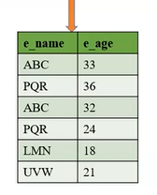
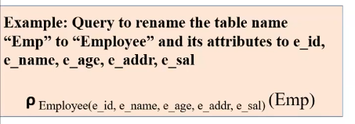
Rename Operation
5

Slide 14
Rename Operation
5
For most queries, we need to apply several relational algebra operations one after the other.
Either we can write the operations as a single relational algebra expression by nesting the operations, or we can apply one operation at a time and create intermediate result relations.
In the latter case, we must give names to the relations that hold the intermediate results.

Slide 15

Rename Operation
5
For example, to retrieve the first name, last name, and salary of all employees who work in department number 5, we must apply a SELECT and a PROJECT operation. We can write a single relational algebra expression, also known as an in-line expression, as follows:
Alternatively, we can explicitly show the sequence of operations, giving a name to each intermediate relation, as follows:

Slide 16
Rename Operation
5
Renaming in SQL is accomplished by aliasing using AS, as in the following
example:
SELECT E.Fname AS First_name,
E.Lname AS Last_name,
E.Salary AS Salary
FROM EMPLOYEE AS E
WHERE E.Dno=5
If only one table is used in the query and column names are not ambiguous, you can omit E.
If more than one table has the same column name, you must qualify the column.

Slide 17
Union Operation
5
The union operation allows us to combine two relations
Notation: r ∪ s
For r ∪ s to be valid.
1. The relations r and s must be of the same arity. That is, they must have the
same number of attributes.
2. The domains of the ith attribute of r and the ith attribute of s must be the
same, for all i.
Note that r and s can be either database relations or temporary relations that are the result of relational-algebra expressions.
Example: to find all courses taught in the Fall 2009 semester, or in the Spring 2010 semester, or in both
∏_{course_id} (σ _{semester=“Fall” Λ year=2009} (section)) ∪
∏_{course_id} (σ _{semester=“Spring” Λ year=2010}(section))

Slide 18
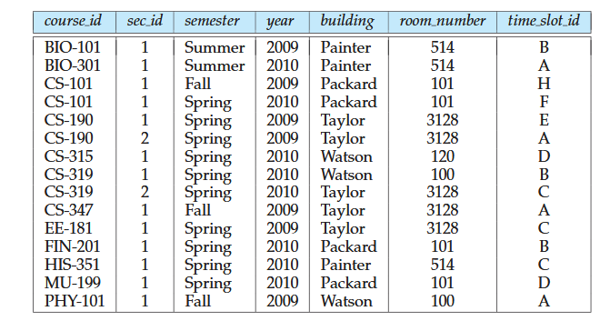
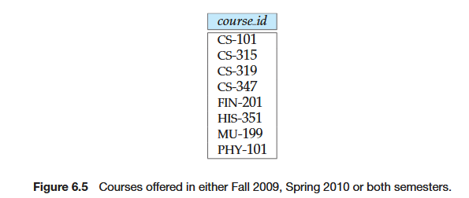
Union Operation
5

Slide 19
Union Operation
5
∏_{course_id} (σ _{semester=“Fall” Λ year=2009} (section)) ∪
∏_{course_id} (σ _{semester=“Spring” Λ year=2010} (section))
In SQL,
SELECT course_id FROM section
WHERE semester=“Fall” AND year=2009
UNION
SELECT course_id FROM section
WHERE semester=“Fall” AND year=2010

Slide 20
Union Operation
5
Example: Consider the following two relations:
A
B
A
B
C
D
α
α
β
1
2
1
α
α
β
β
1
2
1
3
α
β
2
3
r ∪ s:
s
r

Slide 21
Intersection Operation
5
The set-intersection operation allows us to find tuples that are in both the input relations.
Notation: r ∩ s
Assume:
  r, s have the same arity
  attributes of r and s are compatible
Example: Find the set of all courses taught in both the Fall 2009 and the Spring 2010 semesters.
∏_{course_id} (σ _{semester=“Fall” Λ year=2009} (section)) ∩
∏_{course_id} (σ _{semester=“Spring” Λ year=2010} (section))

Slide 22
Intersection Operation
5
Example: Consider the following two relations:
A
B
C
D
A
B
α
α
β
1
2
1
α
β
2
3
α
2
s
r
We also can write: r ∩ s= r-(r-s)

Slide 23
Set Difference Operation
5
The set-difference operation allows us to find tuples that are in one relation but are not in another.
Notation r – s
Set differences must be taken between compatible relations.
  r and s must have the same arity
  attribute domains of r and s must be compatible
Example: to find all courses taught in the Fall 2009 semester, but not in the Spring 2010 semester
∏_{course_id} (σ _{semester=“Fall” Λ year=2009} (section)) −
∏_{course_id} (σ _{semester=“Spring” Λ year=2010}(section))

Slide 24
Difference Operation
5
∏_{course_id} (σ _{semester=“Fall” Λ year=2009} (section)) −
∏_{course_id} (σ _{semester=“Spring” Λ year=2010} (section))
SELECT course_id FROM section
WHERE semester=“Fall” AND year=2009
MINUS
SELECT course_id FROM section
WHERE semester=“Fall” AND year=2010

Slide 25
Difference Operation
5
A
B
A
B
Relations r, s:
α
α
β
1
2
1
α
β
2
3
s
r
A
B
r – s:
α
β
1
1

Slide 26
Assignment Operation
5
It is convenient at times to write a relational-algebra expression by assigning parts of it to temporary relation variables.
The assignment operation is denoted by ← and works like assignment in a programming language.
Example: Find all instructor in the “Physics” and Music department.
Physics ← σ _{dept_name=“Physics”} (instructor)
  Music ← σ _{dept_name=“Music”} (instructor)
  Physics ∪ Music
With the assignment operation, a query can be written as a sequential program consisting of a series of assignments followed by an expression whose value is displayed as the result of the query

Slide 27
Cartesian-product Operation
5
The Cartesian-product operation (denoted by X) allows us to combine information from any two relations.
Example: the Cartesian product of the relations instructor and teaches is written as:
instructor X teaches
We construct a tuple of the result out of each possible pair of tuples: one from the instructor relation and one from the teaches relation (see next slide)
Since the instructor ID appears in both relations we distinguish between these attribute by attaching to the attribute the name of the relation from which the attribute originally came.
  instructor.ID
  teaches.ID

Slide 28
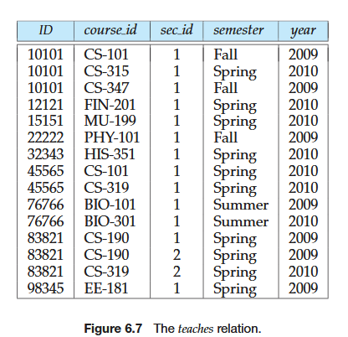
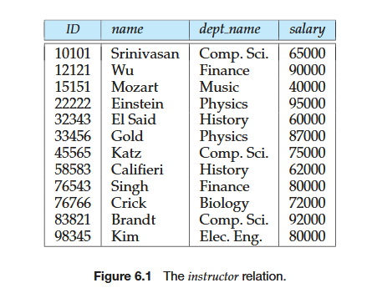
Cartesian-product Operation
5

Slide 29
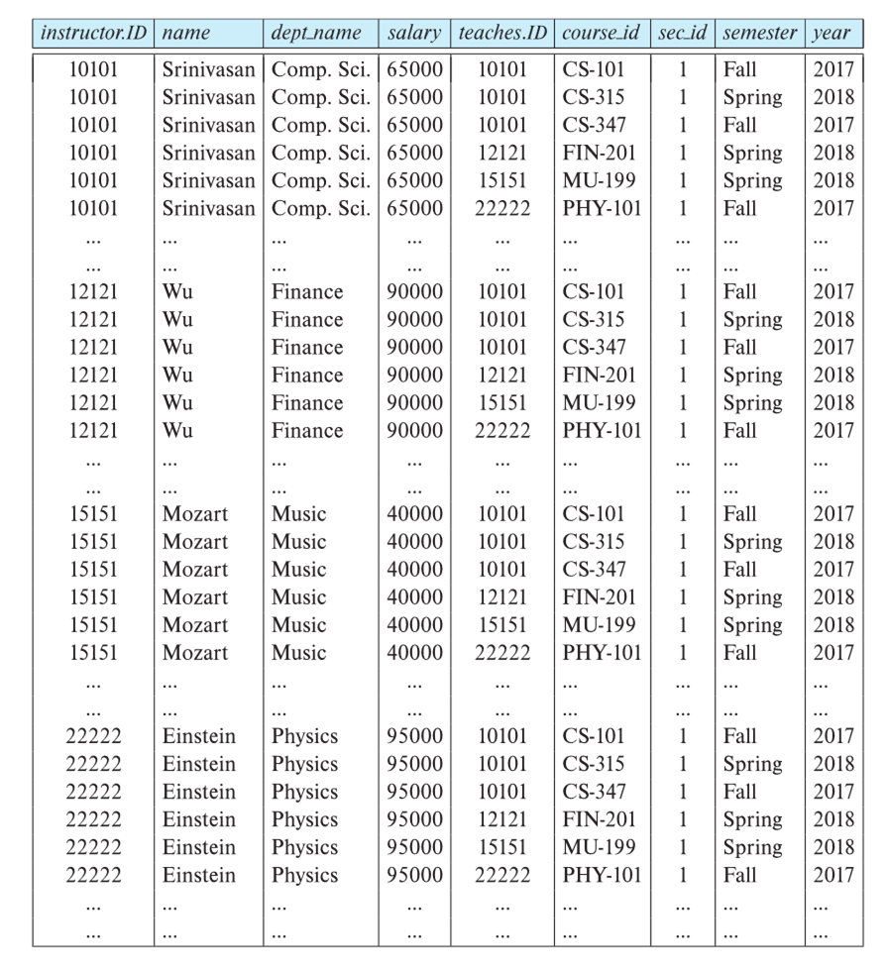
Cartesian-product Operation
5

Slide 30
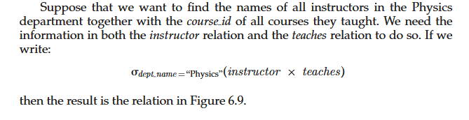
Cartesian-product Operation
5

Slide 31
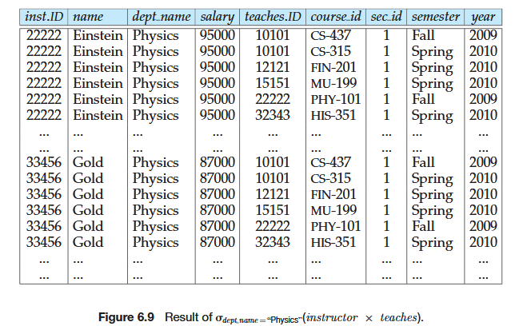
Cartesian-product Operation
5

Slide 32

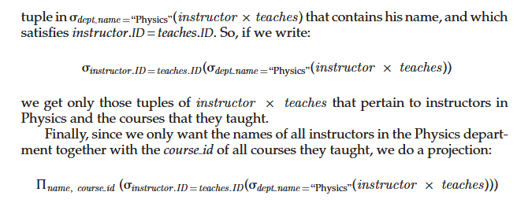
Cartesian-product Operation
5

Slide 33
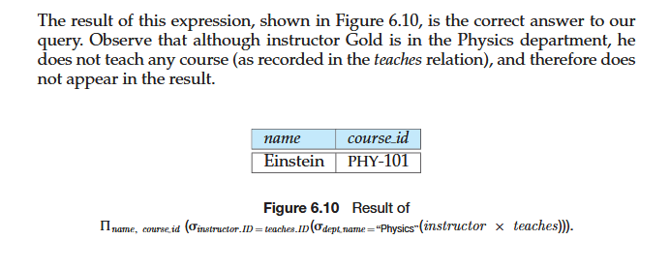
Cartesian-product Operation
5

Slide 34
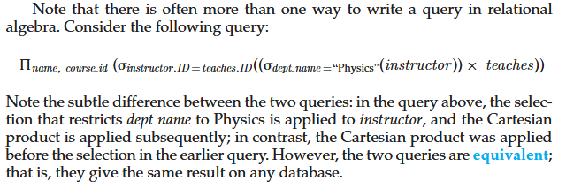
Cartesian-product Operation
5

Slide 35
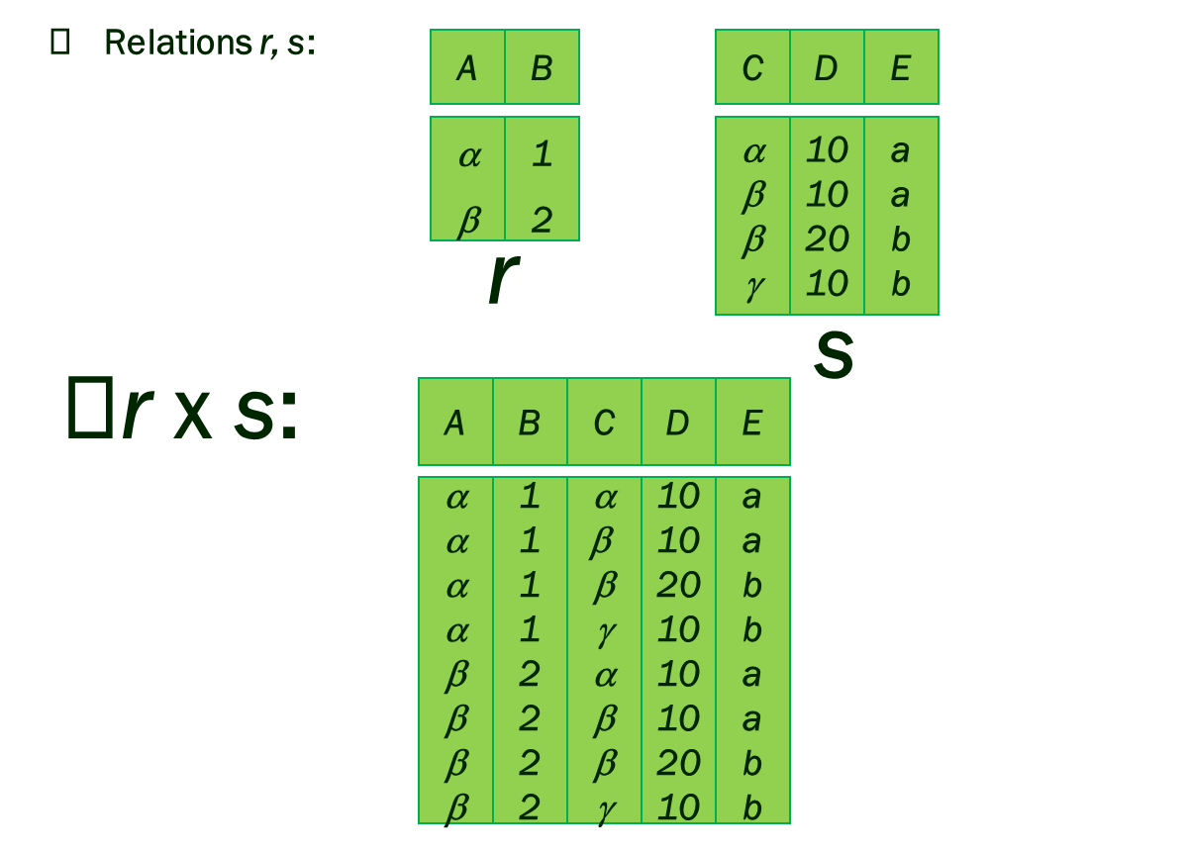
Cartesian-product Operation
5

Slide 36
Cartesian-product Operation
5
In SQL,
SELECT
instructor.*,
teaches.*
FROM
instructor
CROSS JOIN
teaches;

Slide 37
Join Operation
5
The Cartesian-Product
instructor X teaches
associates every tuple of instructor with every tuple of teaches. Most of the resulting rows have information about instructors who did NOT teach a particular course.
To get only those tuples of “instructor X teaches “ that pertain to instructors and the courses that they taught, we write:
σ _{instructor.id = teaches.id} (instructor x teaches ))
  We get only those tuples of “instructor X teaches” that pertain to instructors and the courses that they taught.
The result of this expression, shown in the next slide

Slide 38
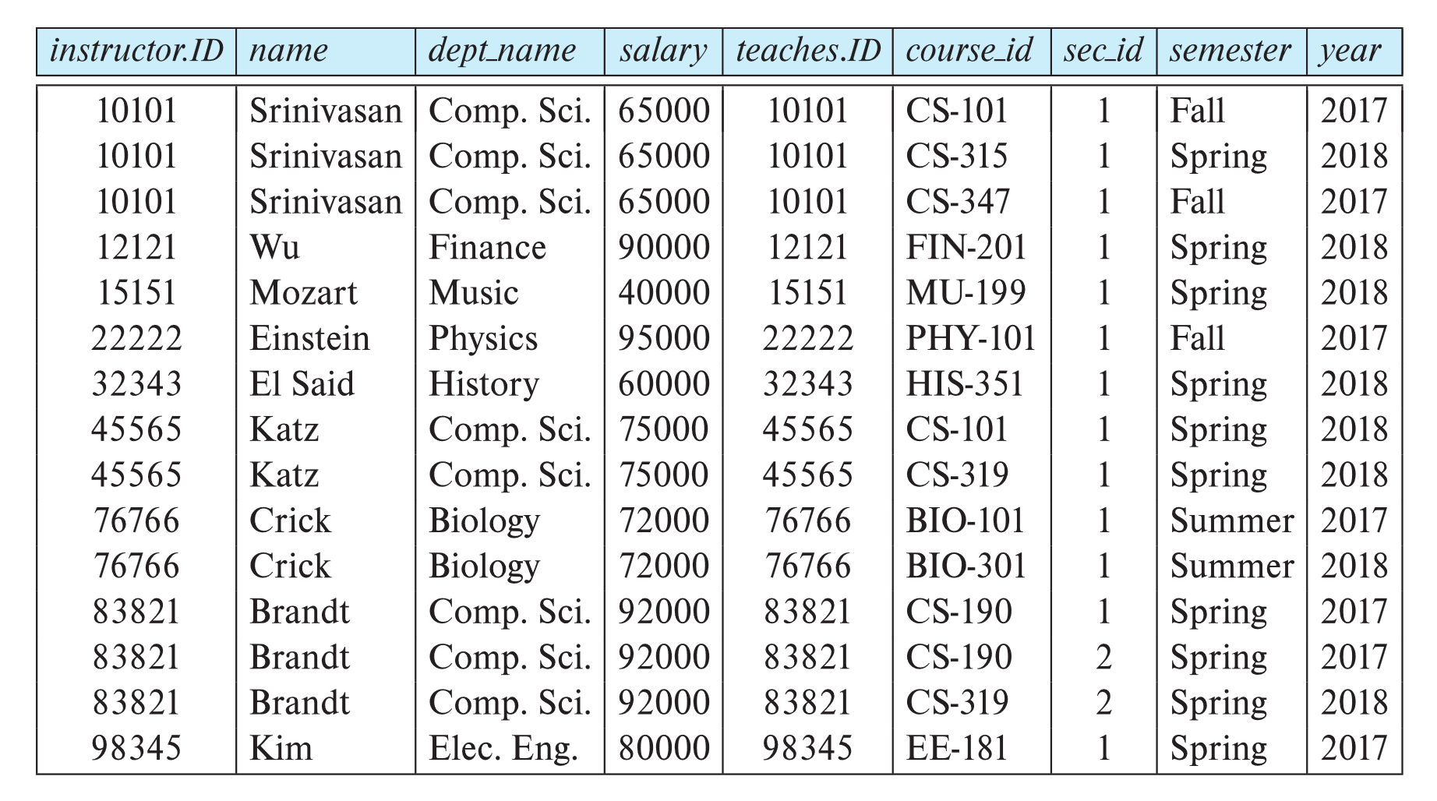
Join Operation
5

Slide 39
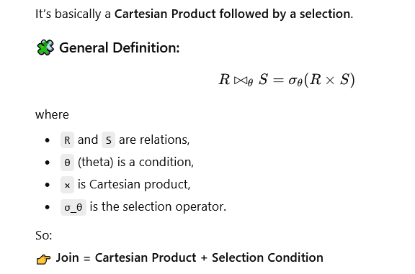
Join Operation
5
Instructor
ID | Name | Dept
1 | Alice | CSE
2 | Bob | EEE
Teaches
ID | Course
1 | DBMS
3 | AI
(a) Cartesian Product
Instructor×Teaches
(b) Theta Join (condition: Instructor.ID = Teaches.ID)
Instructor⋈ Instructor.ID=Teaches.IDTeaches

Slide 40
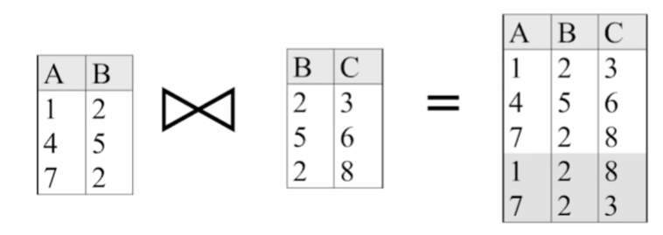
Join Operation
5

Slide 41
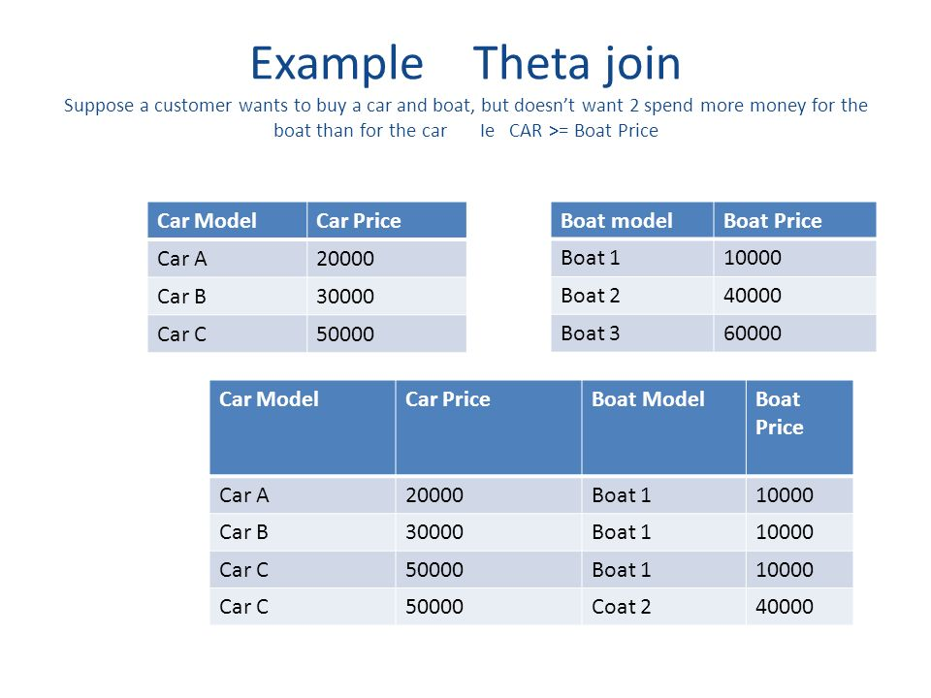
Join Operation
5

Slide 42
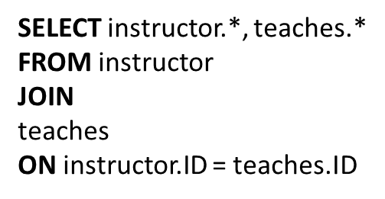
Join Operation
5
SELECT instructor.*, teaches.*
FROM instructor , teaches
WHERE instructor.ID = teaches.ID

Slide 43

Join Operation
5

Slide 44
Example Queries
5
Banking Example
branch (branch_name, branch_city, assets)
customer (customer_name, customer_street, customer_city)
account (account_number, branch_name, balance)
loan (loan_number, branch_name, amount)
depositor (customer_name, account_number)
borrower (customer_name, loan_number)

Slide 45
Example Queries
5
Find all loans of over $1200
σ_{amount > 1200} (loan)
Find the loan number for each loan of an amount greater than $1200
∏_{loan_number} (σ_{amount} _{> 1200} (loan))

Slide 46
Example Queries
5
Find the names of all customers who have a loan, an account, or both, from the bank
  ∏_{customer_name} (borrower) ∪ ∏_{customer_name} (depositor)
Find the names of all customers who have a loan at the Perryridge branch.
∏_{customer_name} (σ_{branch_name=“Perryridge”}
(σborrower.loan_number = loan.loan_number(borrower x loan)))
Or,
∏_{customer_name} (σ_{branch_name=“Perryridge”}
((borrower ⋈ loan)))

Slide 47
Example Queries
5
Find the names of all customers who have a loan at the
Perryridge branch but do not have an account at any branch of
the bank.
∏_{customer_name} (σ_{branch_name = “Perryridge”}
(σborrower.loan_number = loan.loan_number(borrower x loan))) – ∏_{customer_name}(depositor)
∏_{customer_name} (σ_{branch_name = “Perryridge”} ( (borrower ⋈ loan))) – ∏_{customer_name}(depositor)

Slide 48
Example Queries
5
Find the names of all customers who have a loan at the Perryridge branch.
  Query 1
  ∏_{customer_name} (σ_{branch_name = “Perryridge”} (
  σborrower.loan_number = loan.loan_number (borrower x loan)))
  Query 2
  ∏_{customer_name}( ( (σ_{branch_name = “Perryridge”} (loan)) ⋈ borrower))

Slide 49
Example Queries
5
Find the largest account balance
  Strategy:
    Find those balances that are not the largest
      Rename account relation as d so that we can compare each account balance with all others
    Use set difference to find those account balances that were not found in the earlier step.
∏_{balance}(account) - ∏_{account.balance}
(σ_{account.balance < d.balance} (account x ρ_{d} (account)))

Slide 50
Example Queries
5
Find the name of all customers who have a loan at the bank and the loan amount
  ∏customer_name, loan_number, amount (borrower ⋈ loan)
Find the names of all customers who have a loan and an account at bank.
  ∏_{customer_name} (borrower) ∩ ∏_{customer_name} (depositor)

Slide 51
Example Queries
5
Find all customers who have an account from at both the “Downtown” and the Uptown” branches.
    ∏_{customer_name} (σ_{branch_name = “Downtown”} (depositor ⋈ account )) ∩
    ∏_{customer_name} (σ_{branch_name = “Uptown”} (depositor ⋈ account))

Slide 52
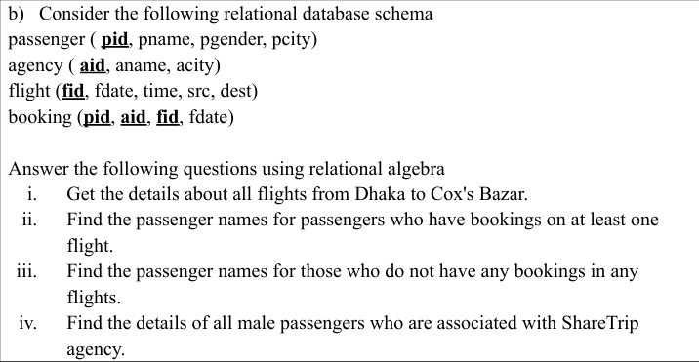
Example Queries
5

Slide 53
Example Queries
5
More Queries:
Find only the flight numbers for passenger with pid 123 for flights to Chennai before 06/11/2020.
Find the agency names for agencies that located in the same city as passenger with passenger id 123.
Get the details of flights that are scheduled on both dates 01/12/2020 and 02/12/2020 at 16:00 hours.

Slide 54
Example Queries
5
More Queries:
Get the details of flights that are scheduled on either of the dates 01/12/2020 or 02/12/2020 or both at 16:00 hours.
Find the agency names for agencies who do not have any bookings for passenger with id 123.

Slide 55
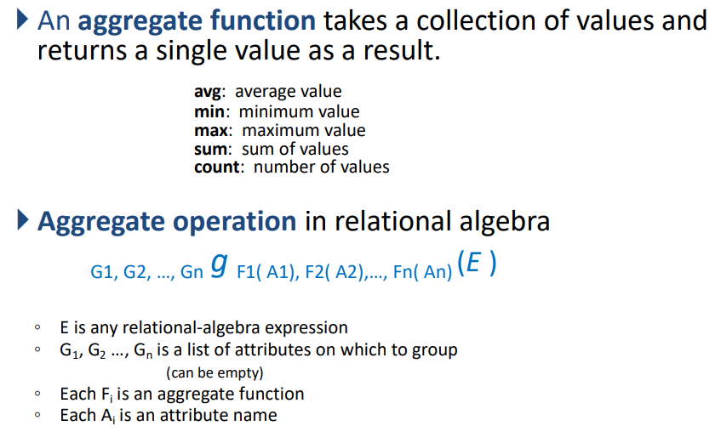
Aggregate Operation
5

Slide 56
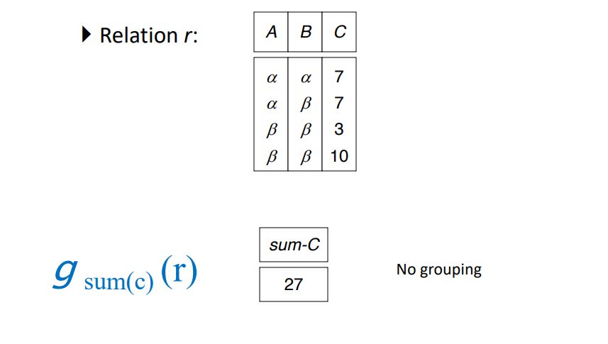
Aggregate Operation
5

Slide 57
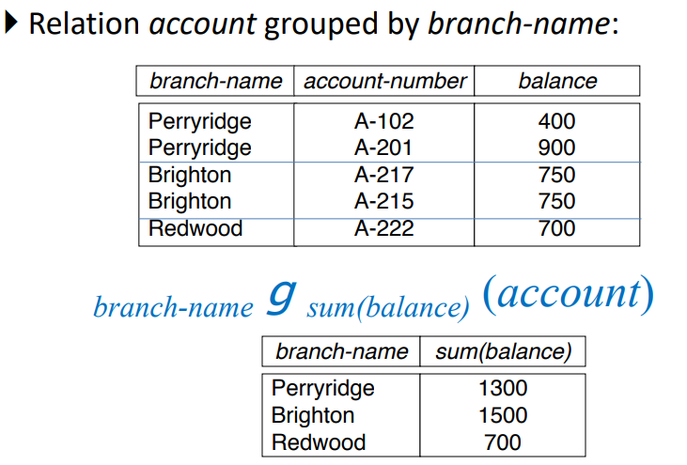
Aggregate Operation
5

Slide 58
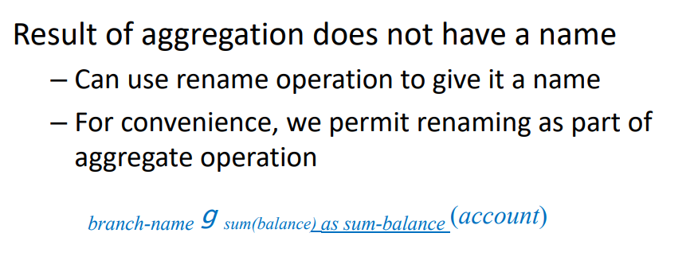
Aggregate Operation
5

Slide 59
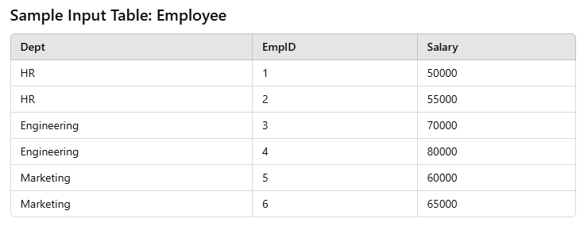
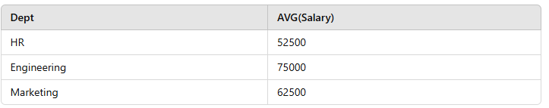
Aggregate Operation
5
Average Salary per Department
Relational Algebra Expression:
Dept g AVG(Salary)(Employee)

Slide 60
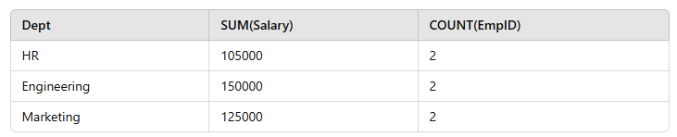
Aggregate Operation
5
Total Salary and Count of Employees per Department
Algebra Expression:
Dept g SUM(Salary),COUNT(EmpID)(Employee)

Slide 61
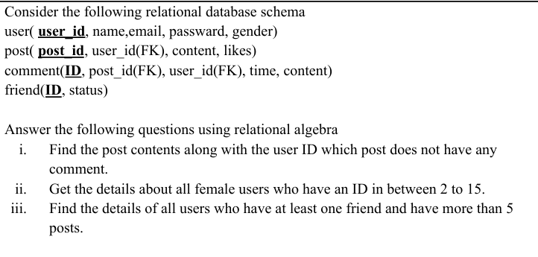
Example Queries
5

Slide 62
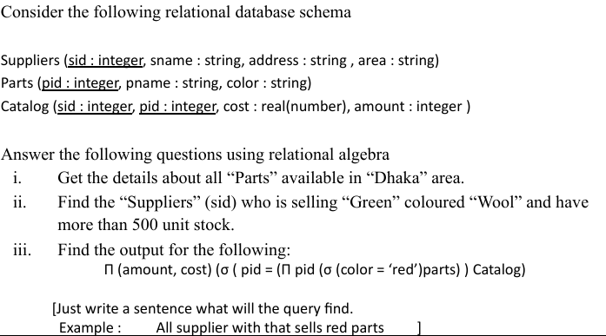
Example Queries
5

Slide 63
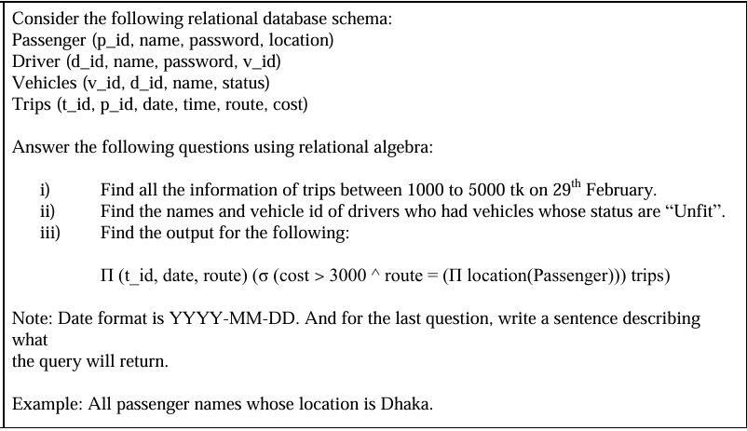
Example Queries
5

Slide 64
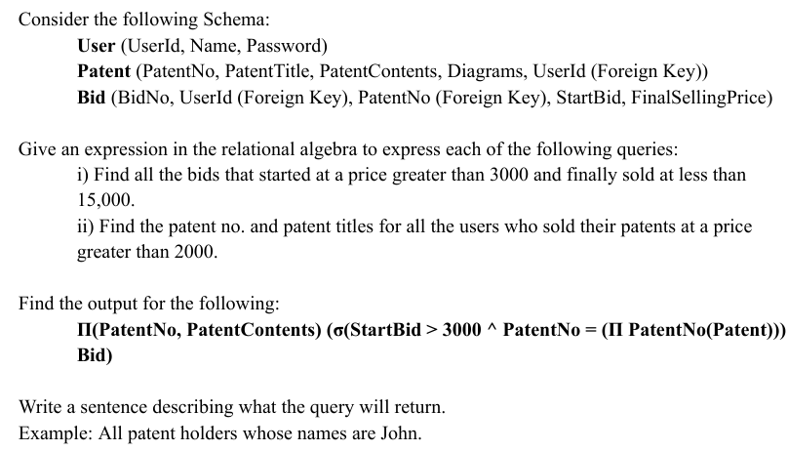
Example Queries
5

Slide 65
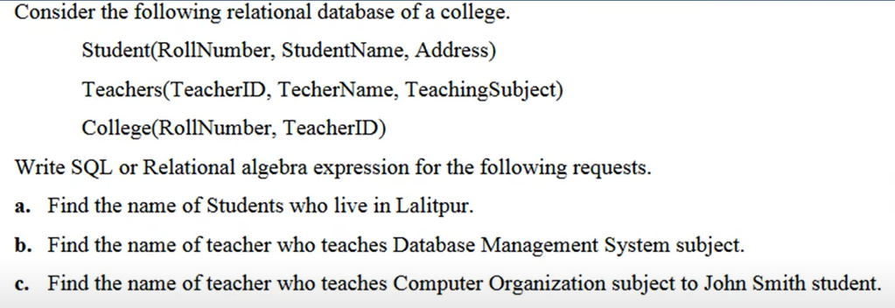
Example Queries
5

Slide 66
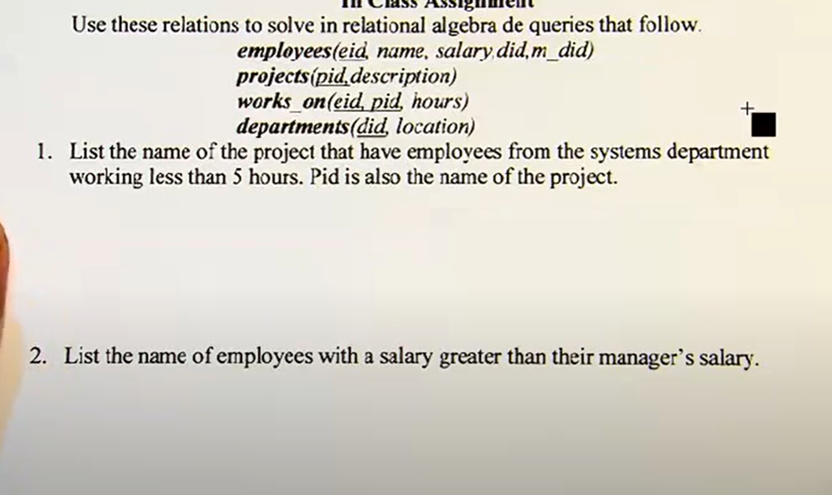
Example Queries
5

Slide 67
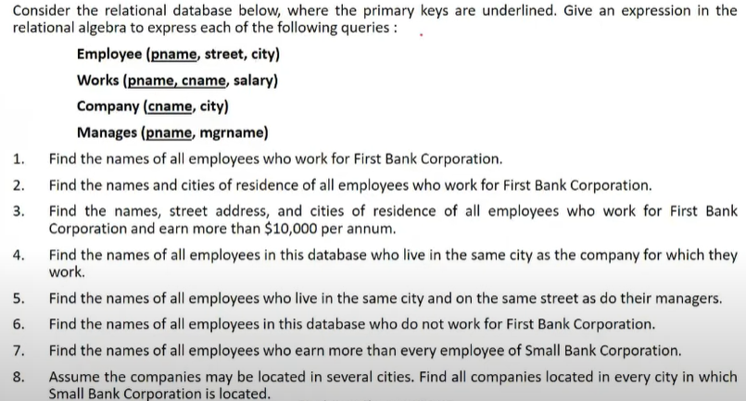
Example Queries
5

Slide 68

Example Queries
5

